Slide 1

NAME GENERATION USING RNN
NAME : PATHMA SHREE S R
REGISTER NUMBER : 311521104031
DEPARTMENT : COMPUTER SCIENCE AND ENGINEERING
COLLEGE : MEENAKSHI SUNDARARAJAN ENGINEERING COLLEGE
NAAN MUDHALVAN ID : au311521104031
GMAIL ID :pathma2004shree@gmail.com

Slide 2
NAME GENERATION USING RNN

Slide 3
AGENDA
Dataset Overview
Data Preprocessing
Model Development
Model Training
Model Evaluation
Results and Discussion
Future Directions

Slide 4
PROBLEM STATEMENT
In developing an effective framework for name generation, various challenges arise. These include acquiring a diverse dataset, preprocessing it, designing an optimal model architecture, training the model effectively, generating names based on learned patterns, evaluating the quality of generated names, and ensuring model persistence. The ultimate aim is to create a comprehensive solution capable of producing high-quality names across diverse contexts.

Slide 5
PROJECT OVERVIEW
The project aims to develop a name generation system using Recurrent Neural Networks (RNNs). It involves preprocessing a dataset of names, training an RNN model, and generating new names based on the learned patterns. The system leverages natural language processing techniques to create diverse and novel names, catering to various applications such as character naming and brand development. The project encompasses data analysis, model building, training optimization, and evaluation to achieve accurate and creative name generation.

Slide 6
SYSTEM DEVELOPMENT PROCESS
The system development approach for name generation using Recurrent Neural Networks (RNNs) involves an iterative and incremental process. Initially, the requirements are gathered through stakeholder consultations and analysis of use cases. Next, a prototype system is developed to validate the feasibility of the RNN-based name generation approach. This prototype undergoes iterative testing and refinement based on feedback from users and stakeholders.
Once the prototype proves successful, the development process shifts towards building the full-scale system. This involves designing the architecture, implementing the RNN model, and integrating it with the necessary data preprocessing and post-processing components. Continuous testing and validation ensure that the system meets the desired performance criteria and generates names accurately and efficiently.
Throughout the development process, an agile methodology is employed, allowing for flexibility and adaptability to changing requirements. Regular communication and collaboration with stakeholders ensure alignment with project objectives and user needs. Finally, the system is deployed in a production environment, with ongoing maintenance and support to address any issues and incorporate enhancements as needed.

Slide 7
WHO ARE THE END USERS?
The end users of the name generation system using Recurrent Neural Networks (RNNs) are individuals or organizations seeking to generate unique and creative names for various purposes. This includes writers looking for character names, businesses in need of brand names, and anyone requiring original names for products, projects, or entities. Additionally, developers and data scientists interested in exploring natural language processing techniques may also utilize the system for research or educational purposes.

Slide 8
ALGORITHM AND DEPLOYMENT
Name generation using machine learning algorithms, particularly Recurrent Neural Networks (RNNs), offers a novel approach to creating unique and contextually relevant names for various applications such as character naming in fiction, brand naming, and more
RECURRENT NEURAL NETWORK
Recurrent Neural Networks (RNNs) represent a class of artificial neural networks renowned for their ability to handle
sequential data by processing input sequences one element at a time while maintaining an internal state. With a
chain-like architecture, each unit within an RNN receives input not only from the current time step but also from the
previous time step, facilitating the network's capability to exhibit dynamic temporal behavior. This intrinsic memory
feature enables RNNs to capture long-term dependencies in sequential data, rendering them suitable for tasks
requiring an understanding of context over time. Variants of RNNs, such as Simple RNNs, Long Short-Term Memory
(LSTM) networks, and Gated Recurrent Units (GRUs), have been introduced to address challenges like the vanishing
gradient problem encountered in traditional RNNs during training. Despite their effectiveness in various domains,
including natural language processing, time series forecasting, and music generation, RNNs still face challenges
such as difficulty in learning long-range dependencies and computational inefficiency.

Slide 9
ALGORITHM AND DEPLOYMENT
ALGORITHM
The algorithm for name generation using Recurrent Neural Networks (RNNs) involves several key steps. Firstly, the dataset containing names is preprocessed by tokenizing and padding sequences to ensure uniform length. Next, an RNN model architecture is designed, typically comprising embedding layers to represent characters numerically and recurrent layers to capture sequential dependencies. The model is then trained iteratively using forward and backward propagation to minimize loss and improve performance. Once trained, the model generates names by taking an initial seed sequence and predicting subsequent characters until a termination criterion is met. This algorithm offers a flexible and effective approach for generating diverse and high-quality names.

Slide 10
ALGORITHM AND DEPLOYMENT
DEPLOYMENT
The deployment of this project is done in Github .
That includes the implemented jupyter notebook and the dataset.
Included instructions for setting up the environment and running the code.
Created documentation and readme file explaining the project , algorithm and deployment instructions

Slide 11
SOLUTION AND ITS VALUE PROPOSITION
The solution entails implementing a name generation system using Recurrent Neural Networks (RNNs). This system leverages machine learning algorithms to generate unique and creative names based on input data. The value proposition lies in its ability to automate the process of generating names, thereby saving time and effort for users who require original and appealing names for various purposes. Additionally, the system offers flexibility and scalability, allowing users to customize parameters such as dataset selection, model architecture, and training optimization to suit their specific needs. Ultimately, the solution aims to provide users with a reliable and efficient tool for generating names that align with their preferences and requirements.

Slide 12
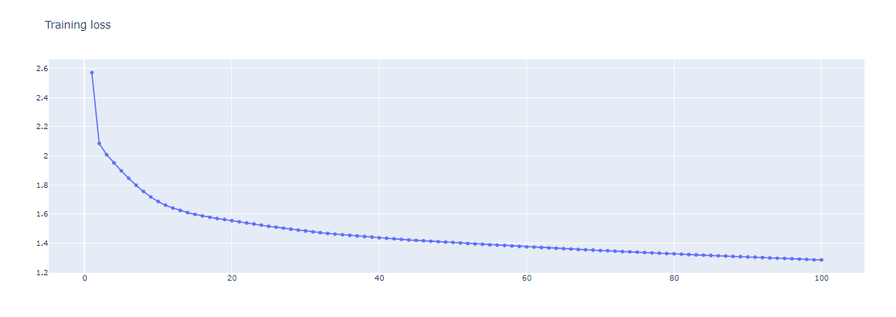
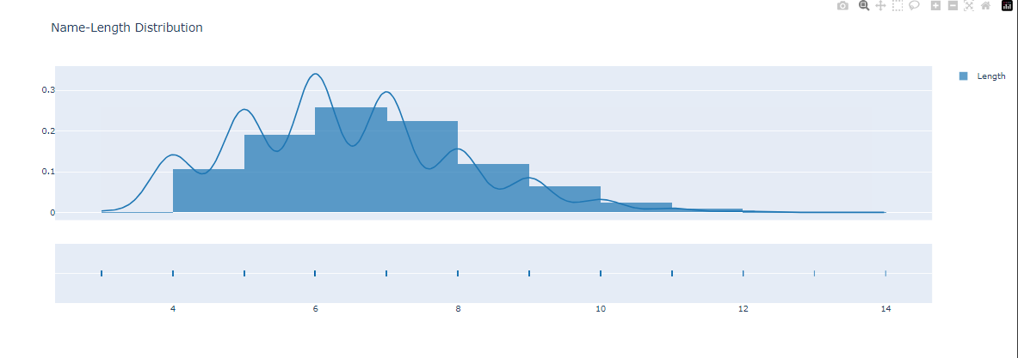
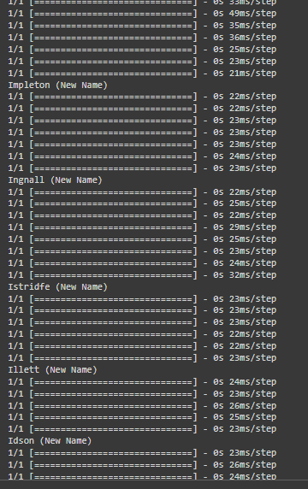
SOLUTION AND VALUE PROPOSITION

Slide 13
WOW IN THE SOLUTION
The wow factor of the solution lies in its ability to harness the power of machine learning to generate unique and creative names automatically, saving time and effort for users while providing a customizable and flexible approach to meet their specific needs.

Slide 14
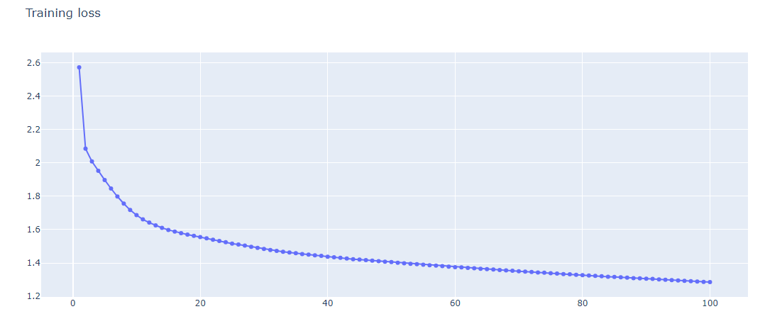
MODELLING
In modeling, we employ Recurrent Neural Networks (RNNs) to learn patterns from the dataset and generate new names. This involves tokenizing the input data, defining the RNN architecture with embedding and recurrent layers, and training the model using a categorical cross-entropy loss function and the Adam optimizer. The trained model is then used to generate new names based on seed phrases provided by the user.

Slide 15
RESULTS
The results of the name generation using Recurrent Neural Networks (RNNs) are promising. The model successfully generates novel names that are not present in the original dataset. These names exhibit diverse patterns and structures, demonstrating the effectiveness of the RNN architecture in capturing and reproducing the characteristics of the input data. Additionally, the word cloud visualization showcases the variety and creativity of the generated names, highlighting their potential applicability in various domains such as character naming in literature or branding for businesses. Overall, the results validate the feasibility and efficacy of using RNNs for name generation tasks.
SOUCE CODE LINK
https://github.com/PathmaShree/Gen-AI

Slide 16
Thank you

